Slide 1

Numerical Integration with Python

Slide 2
Trapezoidal Rule

Slide 3
Integrals
The Indefinite Integral
The indefinite integral of f(x) is a FUNCTION 𝐹(𝑥)
∫ is called the Integral symbol
Where ^{𝑑𝐹(𝑥)} = 𝑓(𝑥)
𝑑x
𝑐 is a constant
The Definite Integral
The definite integral of f(x) is a NUMBER and represents the area
under the curve f(x) from 𝑥 = 𝑎 to 𝑥 = 𝑏
Since the topic is Numerical Integration in Python, we will focus on the Definite Integral

Slide 4
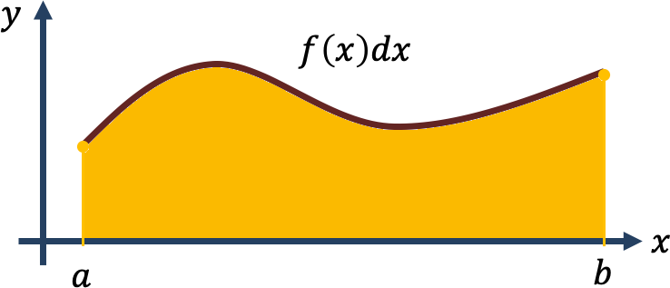
Integration

Slide 5
Example
Given the function:
𝑓(𝑥) = 𝑥²
We know that the exact solution is:
The integral from 0 to 1 is:
We will take it step by step to see how we can solve this using Python

Slide 6
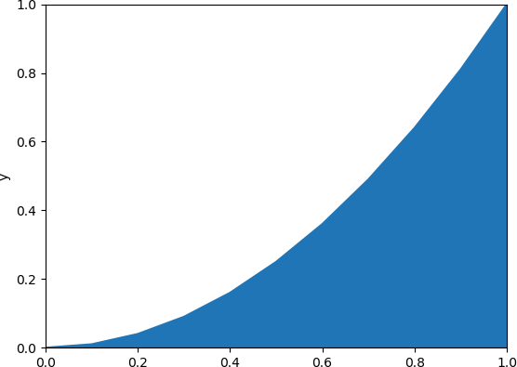
Example
import matplotlib.pyplot as plt import numpy as np
xstart = 0
xstop = 1.1
increment = 0.1
x = np.arange(xstart,xstop,increment)
y = x**2
plt.plot(x, y)
plt.xlabel('x')
plt.ylabel('y') plt.axis([0, 1, 0, 1]) plt.fill_between(x,y) plt.show()
𝑓(𝑥) = 𝑥²
𝑓(𝑥) = 𝑥²
𝐴 = ²
3
1
𝐴 = ₃ ≈ 0.33

Slide 7
Trapezoidal Rule
Approximate function by trapezoid
f(b)
f(a)
a
b

Slide 8
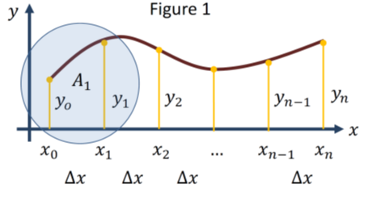
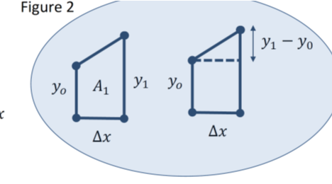
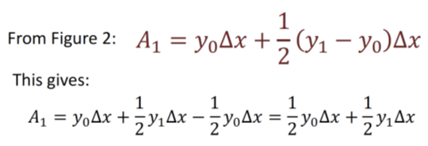
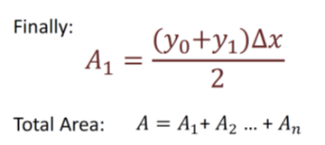
Numerical Integration Approach

Slide 9
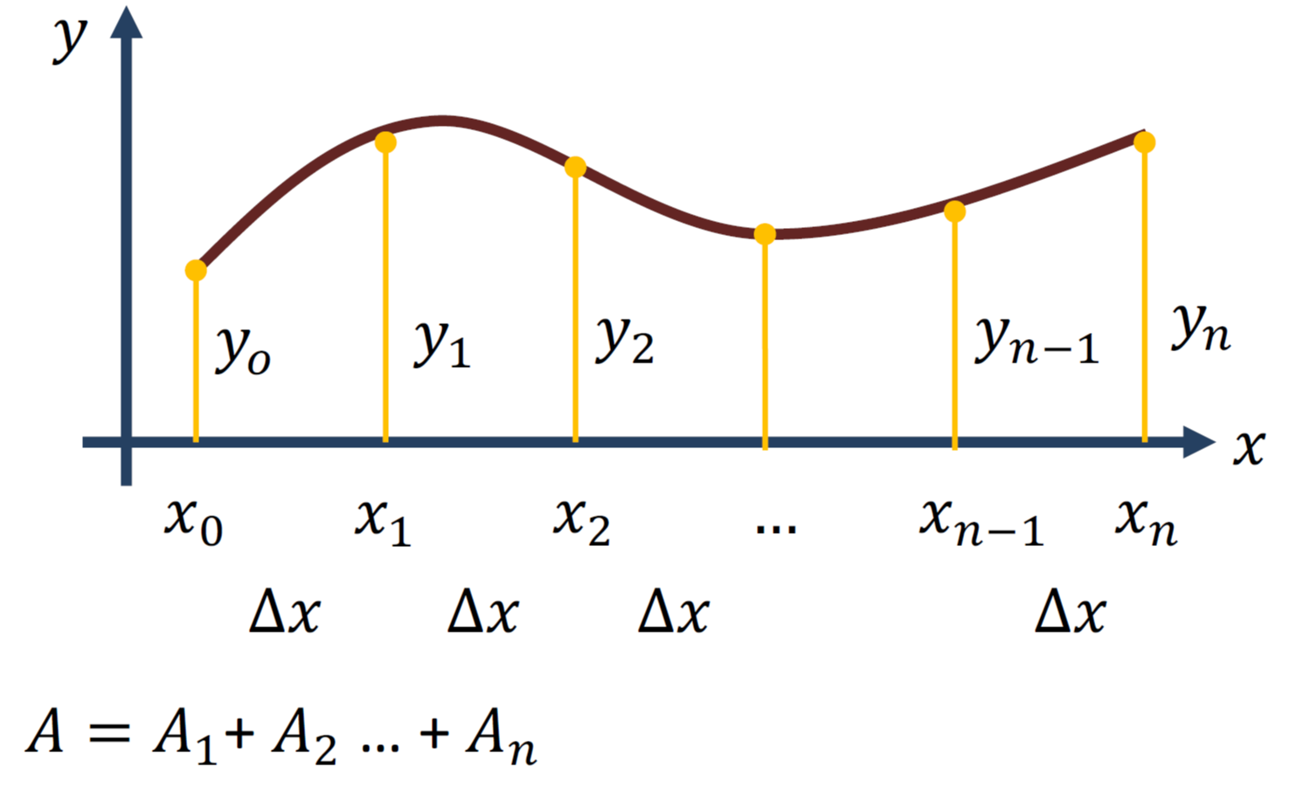
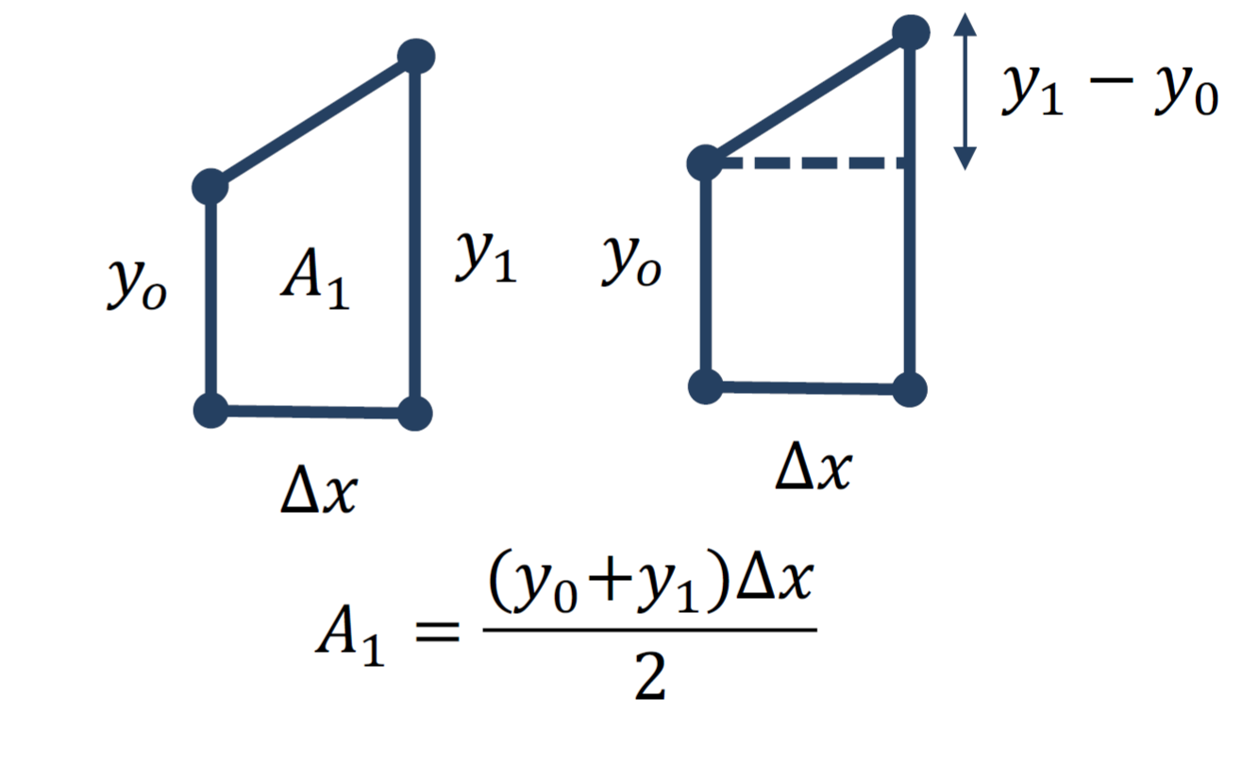
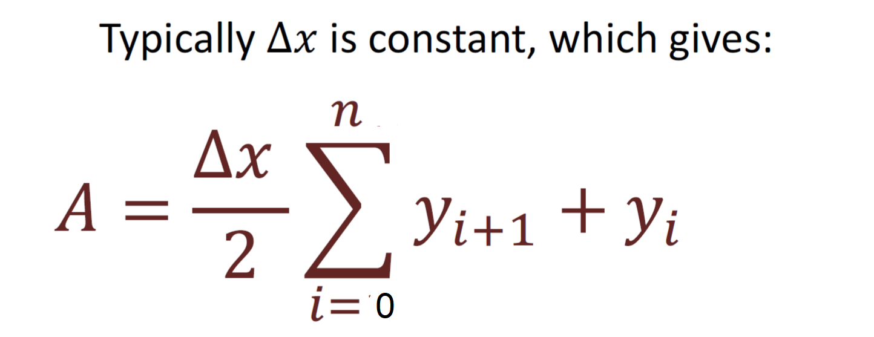
Numerical Integration
=x_{n}
=x₀
-1
(
(

Slide 10
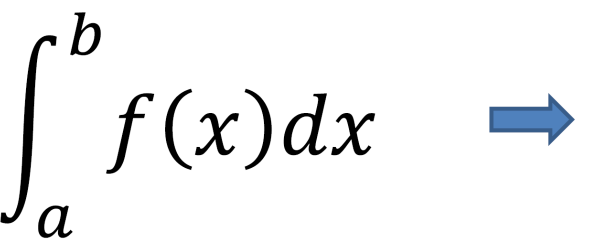
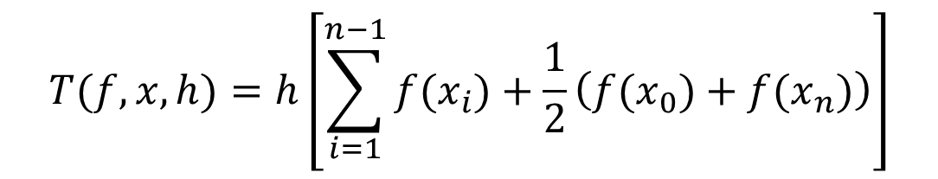
Numerical Integration
Given y = f(x) the approximation of the Area (A) under the curve can be found dividing the area up into rectangles and then summing the contribution from all the rectangles
This is known as the Trapezoid rule.
-1
(
(
$$T(f,x,h)=h\left[\sum_{i=1}^{n−1}{f(x_{i})}+\frac{1}{2}\left(f(x_{0})+f(x_{n})\right)\right]$$

Slide 11

Example: Use the 2-segment trapezoidal rule to numerically integrate from a = 0 to b = 2

Slide 12
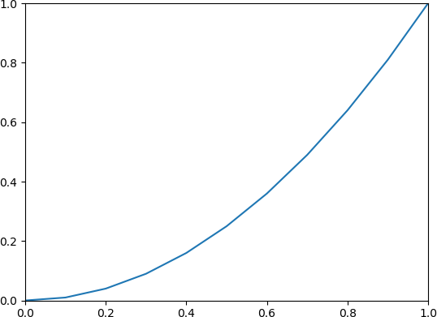
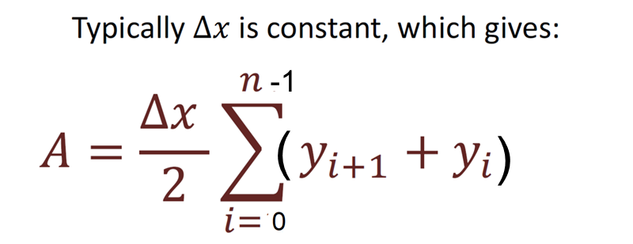
Python Code
import numpy as np
import matplotlib.pyplot as plt
a = 0; b = 1
N = 10
x = np.linspace(a, b ,N+1)
y = x**2;
y_right = y[1:]
y_left = y[:-1]
# Trapezoid Rule
dx = (b - a)/N
A = (dx/2) * np.sum(y_right + y_left)
print("A =", A)
plt.plot(x,y)
plt.xlim([0,1])
plt.ylim([0,1])
𝑓(𝑥) = 𝑥²
Results from the Python code:
A = 0.3350000000000001
Which is a good approximation when we now the exact answer is A = 1/3

Slide 13
SciPy
SciPy has many functions for Numerical Integration
We will use functions in the SciPy Module scipy.integrate
https://docs.scipy.org/doc/scipy/reference/integrate.html

Slide 14
trapz() Function
We start with using the built-in Trapezoid rule function trapz():
A = trapz(y,x,∆𝑥)
𝑥 – Array of x values
𝑦 – Array of y values
∆𝑥 – The spacing between sample point

Slide 15
Python Code - trapz()
Given:
import numpy as np
a = 0
b = 1
N = 10
dx = (b - a)/N
x = np.linspace(a,b,N+1)
y = x**2;
A = np.trapz(y,x,dx)
print(A)
𝑓(𝑥) = 𝑥²

Slide 16
quad() Function
A,err = quad(f, a, b)
𝑓 – Function that shall be integrated
𝑎 – Lower Limit of Integration
𝑏 – Upper Limit of Integration
https://docs.scipy.org/doc/scipy/reference/generated
/scipy.integrate.quad.html#scipy.integrate.quad
16

Slide 17
Python Code – quad()
Given:
𝑓(𝑥) = 𝑥²
We will find the Integral using Python:
This is a very good approximation when we now the exact answer is A = 1/3
from scipy import integrate
a = 0; b = 1
def y(x):
return x**2
A, e = integrate.quad(y, a, b)
print("A =", A)
A = 0.33333333333333337
17

Slide 18
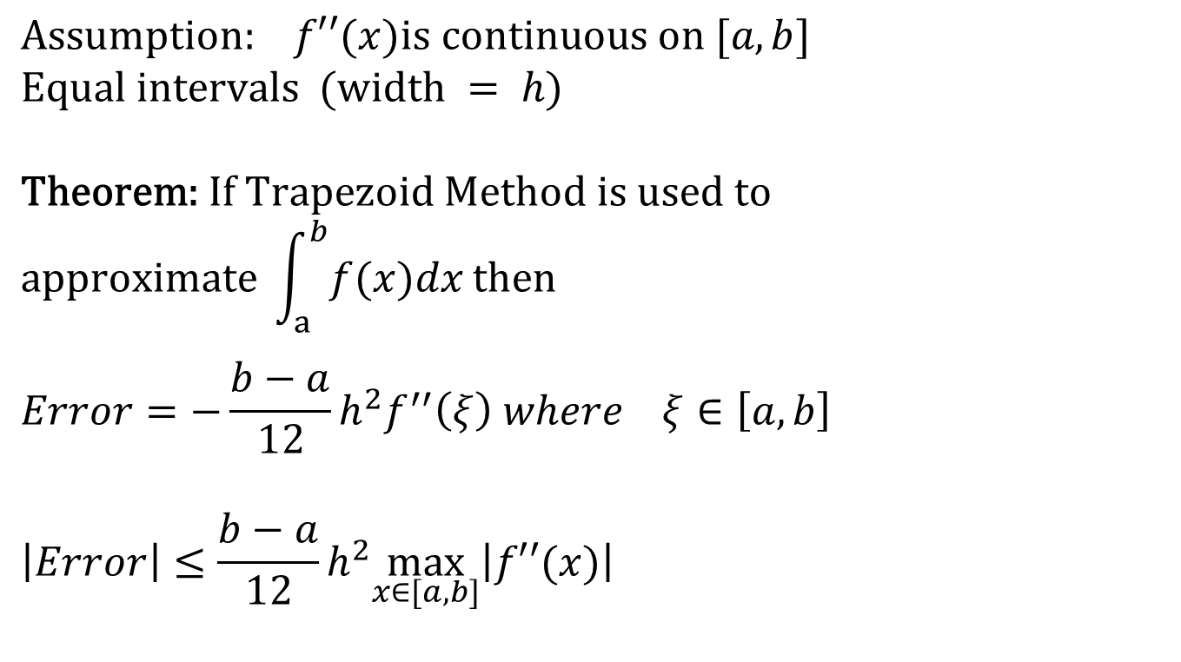
Error in estimating the integral theorem
$$\text{Assumption}\text{: }f′′(x)\text{is} \text{continuous} \text{on} [a,b] \\ \text{Equal} \text{intervals} (\text{width} = h)$$
$$\text{Theorem}\text{: }\text{If} \text{Trapezoid} \text{Method} \text{is} \text{used} \text{to} \\ \text{approximate} \int_{a}^{b}{f(x)dx}\text{then}$$
$$Error=−\frac{b−a}{12}h^{2}f^{′′}\left(ξ\right) where ξ∈\left[a,b\right]$$
$$\left|Error\right|≤\frac{b−a}{12}h^{2}\max_{x∈[a,b]}\left|f′′(x)\right|$$
O(h²)

Slide 19
Notation
We say that the estimate is correct to n decimal digits if:
We say that the estimate is correct to n decimal digits rounded if:

Slide 20
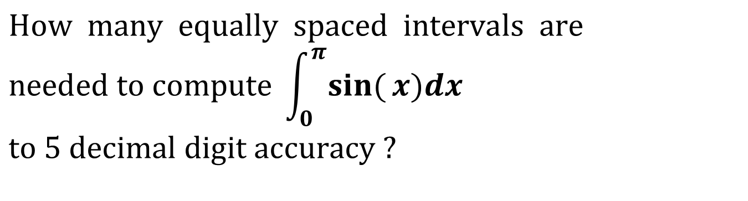
Estimating the Error
For Trapezoid Method
$$\text{How} \text{many} \text{equally} \text{spaced} \text{intervals} \text{are} \\ \text{needed} \text{to} \text{compute} \int_{0}^{π}{\sin{(}x)dx} \\ \text{to} 5 \text{decimal} \text{digit} \text{accuracy}\text{ ?}$$
20

Slide 21
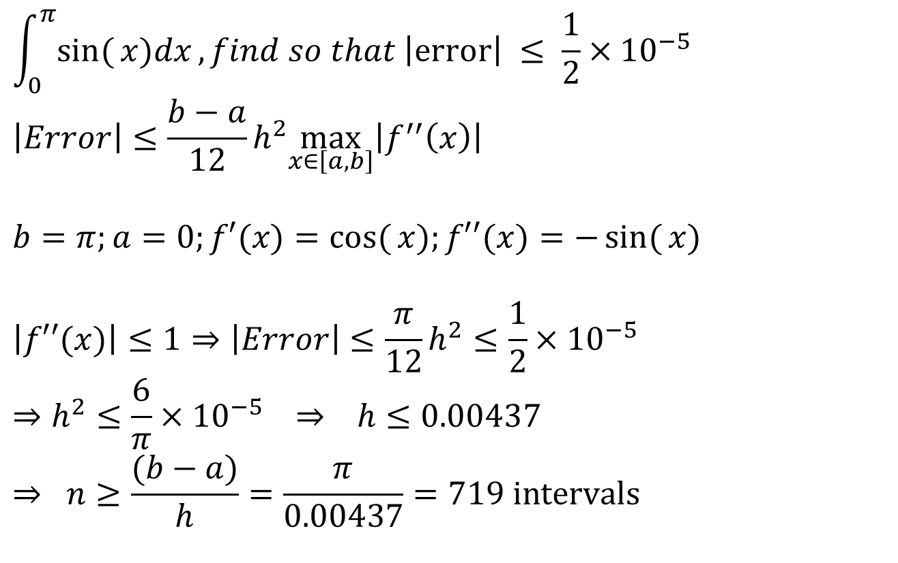
Example
estimate is correct to n decimal digits rounded
$$\int_{0}^{π}{\sin{(}x)dx},find so that \left|\text{error}\right| ≤ \frac{1}{2}×10^{−5}$$
$$\left|Error\right|≤\frac{b−a}{12}h^{2}\max_{x∈\left[a,b\right]}\left|f^{′′}\left(x\right)\right|$$
$$b=π;a=0;f′(x)=\cos{(}x);f′′(x)=−\sin{(}x)$$
$$\left|f′′(x)\right|≤1⇒\left|Error\right|≤\frac{π}{12}h^{2}≤\frac{1}{2}×10^{−5}$$
$$⇒h^{2}≤\frac{6}{π}×10^{−5} ⇒ h≤0.00437$$
$$⇒ n≥\frac{(b−a)}{h}=\frac{π}{0.00437}=719 \text{intervals}$$

Slide 22
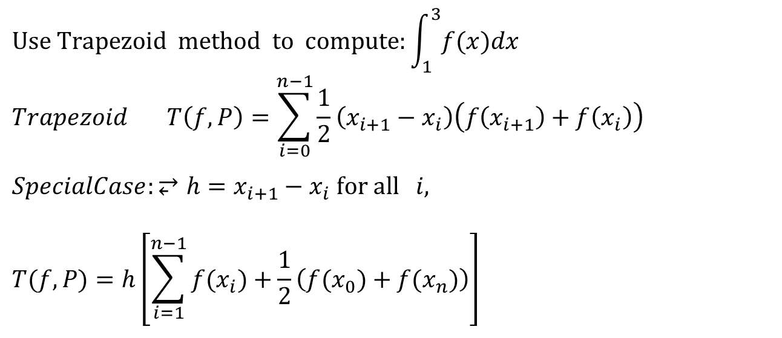
Example
x | 1.0 | 1.5 | 2.0 | 2.5 | 3.0
f(x) | 2.1 | 3.2 | 3.4 | 2.8 | 2.7
$$\text{Use} \text{Trapezoid} \text{method} \text{to} \text{compute}:\int_{1}^{3}{f(x)dx} \\ Trapezoid T\left(f,P\right)=\sum_{i=0}^{n−1}{\frac{1}{2}}\left(x_{i+1}−x_{i}\right)\left(f\left(x_{i+1}\right)+f\left(x_{i}\right)\right)$$
$$SpecialCase:⥂h=x_{i+1}−x_{i} \text{for} \text{all} i,$$
$$T(f,P)=h\left[\sum_{i=1}^{n−1}{f(x_{i})}+\frac{1}{2}\left(f(x_{0})+f(x_{n})\right)\right]$$

Slide 23

Example
x | 1.0 | 1.5 | 2.0 | 2.5 | 3.0
f(x) | 2.1 | 3.2 | 3.4 | 2.8 | 2.7
$$\int_{1}^{3}{f(x)dx}≈h\left[\sum_{i=1}^{n−1}{f\left(x_{i}\right)}+\frac{1}{2}\left(f\left(x_{0}\right)+f\left(x_{n}\right)\right)\right]=0.5\left[3.2+3.4+2.8+\frac{1}{2}\left(2.1+2.7\right)\right] \\ =5.9$$

Slide 24
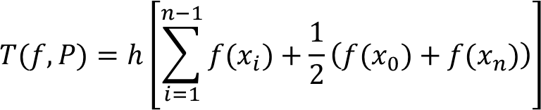
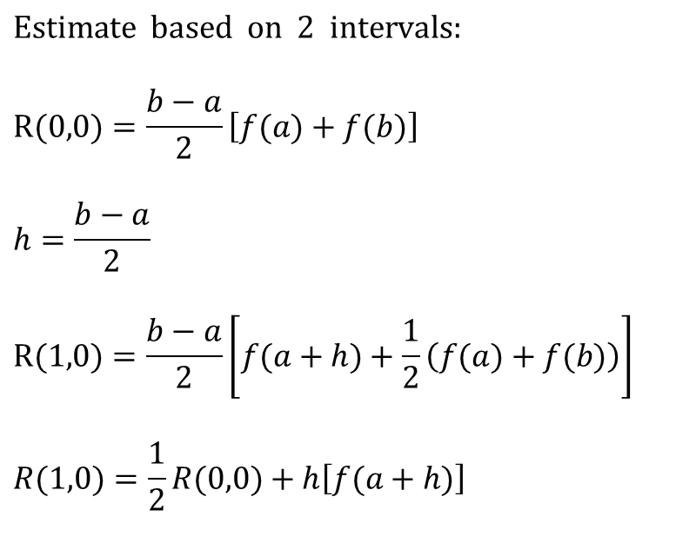
Recursive Trapezoid Method
$$\text{Estimate} \text{based} \text{on} \text{2 }\text{intervals}\text{:}$$
$$R(0,0)=\frac{b−a}{2}\left[f(a)+f(b)\right]$$
$$h=\frac{b−a}{2}$$
$$R(1,0)=\frac{b−a}{2}\left[f(a+h)+\frac{1}{2}\left(f(a)+f(b)\right)\right]$$
$$R(1,0)=\frac{1}{2}R(0,0)+h\left[f(a+h)\right]$$
f(x)
=b
Based on previous estimate
Based on new point

Slide 25

Recursive Trapezoid Method
$$h=\frac{b−a}{4}$$
$$R\left(2,0\right)= \frac{b−a}{4}\left[f(a+h)+f(a+2h)+f(a+3h)\right. \\ +\left.\frac{1}{2}\left(f(a)+f(b)\right)\right]$$
$$R(2,0)=\frac{1}{2}R(1,0)+h\left[f(a+h)+f(a+3h)\right]$$
f(x)
Based on previous estimate
Based on new points

Slide 26

Recursive Trapezoid Method
Formulas
$$R(0,0)=\frac{b−a}{2}\left[f(a)+f(b)\right]$$
$$R(n,0)=\frac{1}{2}R(n−1,0)+h\left[\sum_{k=1}^{2^{(n−1)}}{f\left(a+(2k−1)h\right)}\right] \\ h=\frac{b−a}{2^{n}}$$

Slide 27
Recursive Trapezoid Method

Slide 28
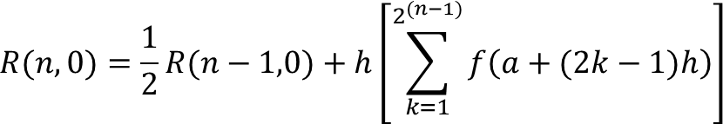
Example on Recursive Trapezoid
n | h | R(n,0)
0 | (b-a)=π/2 | (π/4) [sin(0) + sin(π/2)]=0.785398
1 | (b-a)/2=π/4 | R(0,0)/2 + (π/4) sin(π/4) = 0.948059
2 | (b-a)/4=π/8 | R(1,0)/2 + (π/8)[sin(π/8)+sin(3π/8)] = 0.987116
3 | (b-a)/8=π/16 | R(2,0)/2 + (π/16)[sin(π/16)+sin(3π/16)+sin(5π/16)+ sin(7π/16)] = 0.996785
Estimated Error = |R(3,0) – R(2,0)| = 0.009669

Slide 29
Advantages of Recursive Trapezoid
Recursive Trapezoid:
Gives the same answer as the standard Trapezoid method.
Makes use of the available information to reduce the computation time.
Useful if the number of iterations is not known in advance.

Slide 30
Romberg Method

Slide 31
Motivation for Romberg Method
Trapezoid formula with a sub-interval h gives an error of the order O(h²).
We can combine two Trapezoid estimates with intervals “h” and “h/2” to get a better estimate.
31

Slide 32
Romberg Method
First column is obtained using Trapezoid Method
R(0,0)
R(1,0) | R(1,1)
R(2,0) | R(2,1) | R(2,2)
R(3,0) | R(3,1) | R(3,2) | R(3,3)
The other elements are obtained using the Romberg Method

Slide 33
First Column
Recursive Trapezoid Method
33

Slide 34
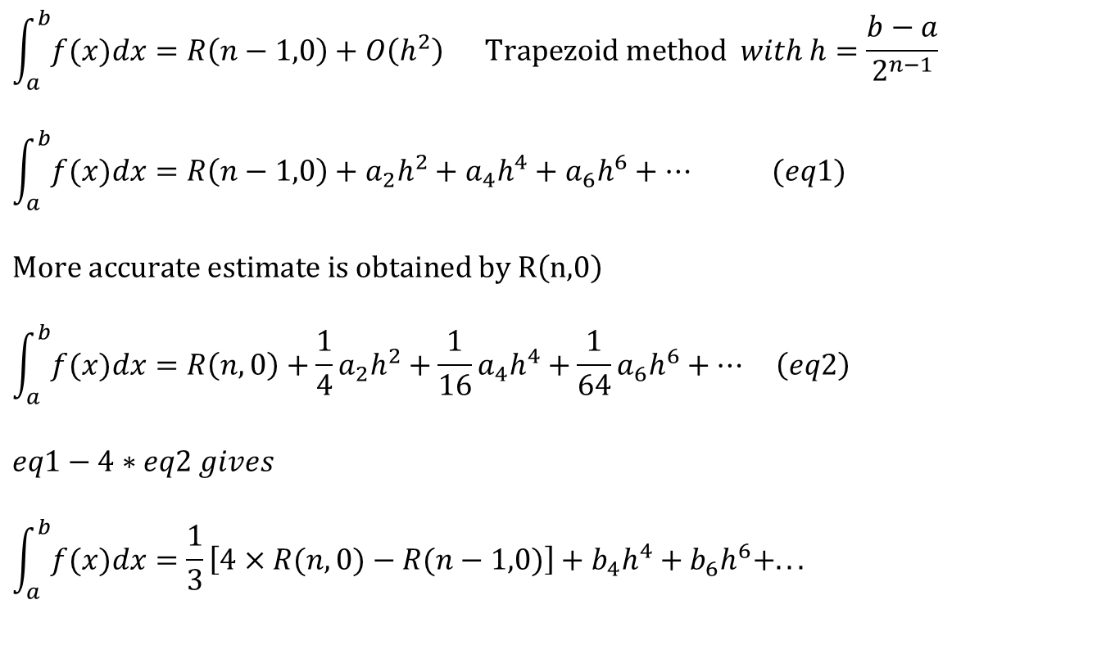
Derivation of Romberg Method
$$\int_{a}^{b}{f(x)dx}=R\left(n−1,0\right)+O\left(h^{2}\right) \text{Trapezoid} \text{method} with h=\frac{b−a}{2^{n−1}}$$
$$\int_{a}^{b}{f(x)dx}=R\left(n−1,0\right)+a_{2}h^{2}+a_{4}h^{4}+a_{6}h^{6}+… (eq1)$$
$$\text{More} \text{accurate} \text{estimate} \text{is} \text{obtained} \text{by} \text{R}\left(\text{n}\text{,0}\right)$$
$$\int_{a}^{b}{f(x)dx}=R\left(n,0\right)+\frac{1}{4}a_{2}h^{2}+\frac{1}{16}a_{4}h^{4}+\frac{1}{64}a_{6}h^{6}+… \left(eq2\right)$$
$$eq1−4∗eq2 gives$$
$$\int_{a}^{b}{f(x)dx}=\frac{1}{3}\left[4×R(n,0)−R(n−1,0)\right]+b_{4}h^{4}+b_{6}h^{6}+...$$
O(h²)

Slide 35
Romberg Method
R(0,0)
R(1,0) | R(1,1)
R(2,0) | R(2,1) | R(2,2)
R(3,0) | R(3,1) | R(3,2) | R(3,3)

Slide 36
Property of Romberg Method
Column
R(0,0)
R(1,0) | R(1,1)
R(2,0) | R(2,1) | R(2,2)
R(3,0) | R(3,1) | R(3,2) | R(3,3)
Error Level
36

Slide 37
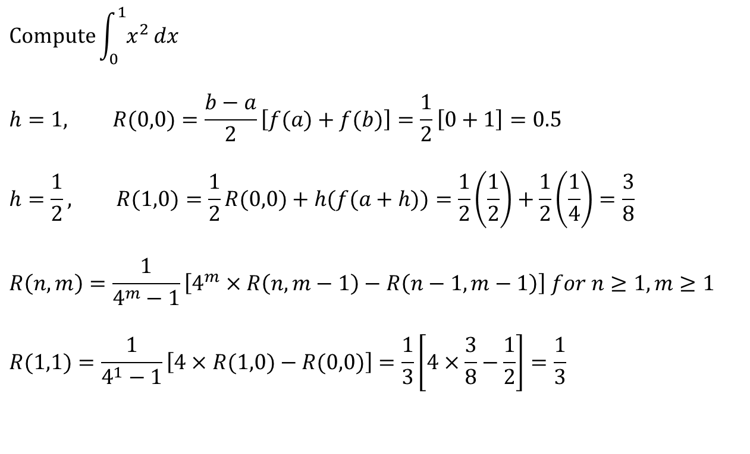
Example
Romberg Table
$$\text{Compute}\int_{0}^{1}{x^{2}}dx$$
$$h=1, R(0,0)=\frac{b−a}{2}\left[f(a)+f(b)\right]=\frac{1}{2}\left[0+1\right]=0.5$$
$$h=\frac{1}{2}, R(1,0)=\frac{1}{2}R(0,0)+h(f(a+h))=\frac{1}{2}\left(\frac{1}{2}\right)+\frac{1}{2}\left(\frac{1}{4}\right)=\frac{3}{8}$$
$$R\left(n,m\right)=\frac{1}{4^{m}−1}\left[4^{m}×R\left(n,m−1\right)−R\left(n−1,m−1\right)\right] for n≥1,m≥1$$
$$R(1,1)=\frac{1}{4^{1}−1}\left[4×R(1,0)−R(0,0)\right]=\frac{1}{3}\left[4×\frac{3}{8}−\frac{1}{2}\right]=\frac{1}{3}$$
0.5
3/8 | 1/3

Slide 38
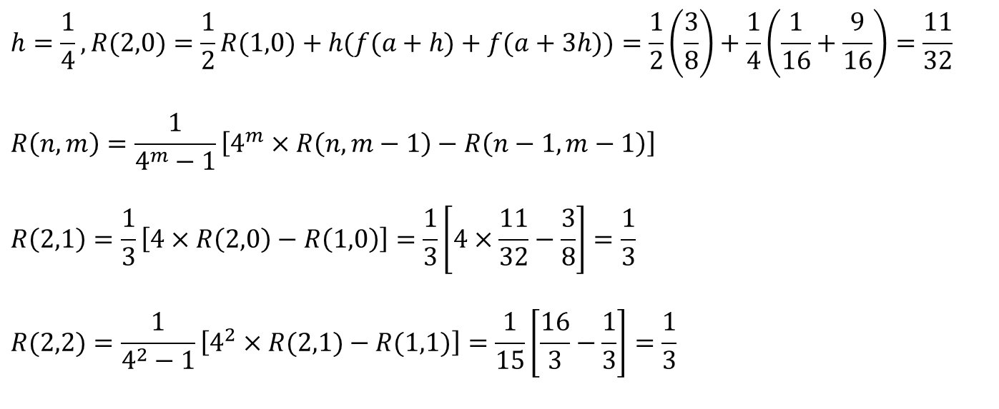
Example (cont.)
0.5
3/8 | 1/3
11/32 | 1/3 | 1/3
$$h=\frac{1}{4},R(2,0)=\frac{1}{2}R(1,0)+h(f(a+h)+f(a+3h))=\frac{1}{2}\left(\frac{3}{8}\right)+\frac{1}{4}\left(\frac{1}{16}+\frac{9}{16}\right)=\frac{11}{32}$$
$$R\left(n,m\right)=\frac{1}{4^{m}−1}\left[4^{m}×R\left(n,m−1\right)−R\left(n−1,m−1\right)\right]$$
$$R\left(2,1\right)=\frac{1}{3}\left[4×R\left(2,0\right)−R\left(1,0\right)\right]=\frac{1}{3}\left[4×\frac{11}{32}−\frac{3}{8}\right]=\frac{1}{3}$$
$$R(2,2)=\frac{1}{4^{2}−1}\left[4^{2}×R(2,1)−R(1,1)\right]=\frac{1}{15}\left[\frac{16}{3}−\frac{1}{3}\right]=\frac{1}{3}$$

Slide 39
When do we stop?

Slide 40
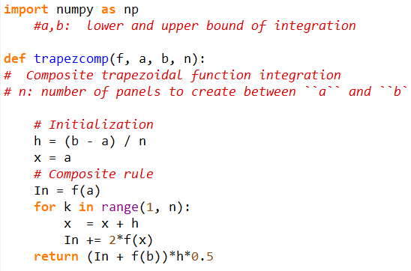
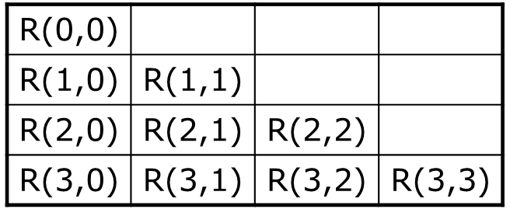
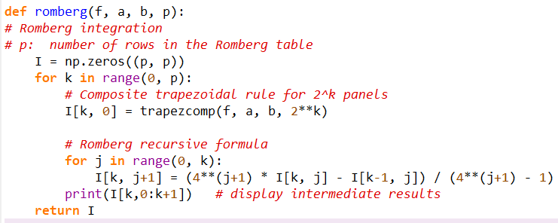
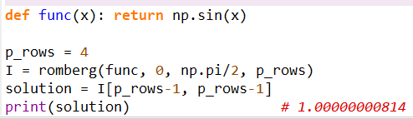
Romberk Code

Slide 41
Simpson Rule

Slide 42
Simpson’s 1/3rd Rule of Integration

Slide 43
Basis of Simpson’s 1/3rd Rule
Trapezoidal rule was based on approximating the integrand by a first
order polynomial, and then integrating the polynomial in the interval of integration. Simpson’s 1/3rd rule is an extension of Trapezoidal rule where the integrand is approximated by a second order polynomial.
Hence
Where is a second order polynomial.

Slide 44
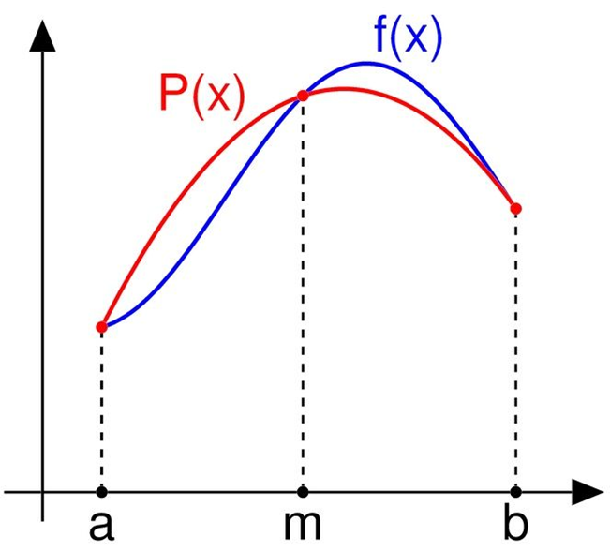
Basis of Simpson’s 1/3rd Rule
Simpson's Rule is based on the fact that given three points, we can find the equation of a quadratic through those points.
Choose
and
as the three points of the function to evaluate a₀, a₁ and a₂.

Slide 45
Basis of Simpson’s 1/3rd Rule
Solving the previous equations for a₀, a₁ and a₂ give

Slide 46
Basis of Simpson’s 1/3rd Rule
Then

Slide 47
Basis of Simpson’s 1/3rd Rule
Substituting values of a₀, a₁, a ₂ give
Since for Simpson’s 1/3rd Rule, the interval [a, b] is broken
into 2 segments, the segment width

Slide 48
Basis of Simpson’s 1/3rd Rule
Hence
Because the above form has 1/3 in its formula, it is called Simpson’s 1/3rd Rule.

Slide 49
Example 1
The distance covered by a rocket from t=8 to t=30 is given by
a) Use Simpson’s 1/3rd Rule to find the approximate value of x
b) Find the true error,
c) Find the absolute relative true error,

Slide 50

Solution
$$x=\int_{8}^{30}{f(t)dt}$$
a)

Slide 51
Solution (cont)
b) The exact value of the above integral is
True Error

Slide 52
Solution (cont)
c) Absolute relative true error,

Slide 53
Multiple Segment Simpson’s 1/3rd Rule

Slide 54
Multiple Segment Simpson’s 1/3rd Rule
Just like in multiple segment Trapezoidal Rule, one can subdivide the interval
[a, b] into n segments and apply Simpson’s 1/3rd rule repeatedly over
every two segments. Note that n needs to be even. Divide interval
[a, b] into equal segments, hence the segment width
where

Slide 55
Multiple Segment Simpson’s 1/3rd Rule
f(x)
.
. . .
.
x
x₀
x₂
x_{n-2}
x_{n}
Apply Simpson’s 1/3rd Rule over each interval,

Slide 56
Multiple Segment Simpson’s 1/3rd Rule
Since

Slide 57
Multiple Segment Simpson’s 1/3rd Rule
Then

Slide 58
Multiple Segment Simpson’s 1/3rd Rule

Slide 59
Example 2
Use 4-segment Simpson’s 1/3rd Rule to approximate the distance
covered by a rocket from t= 8 to t=30 as given by
Use four segment Simpson’s 1/3rd Rule to find the approximate value of x.
Find the true error, for part (a).
Find the absolute relative true error, for part (a).

Slide 60
Solution
a)
Using n segment Simpson’s 1/3rd Rule,
So

Slide 61
Solution (cont.)

Slide 62
Solution (cont.)
cont.

Slide 63
Solution (cont.)
b)
In this case, the true error is
c)
The absolute relative true error

Slide 64
Solution (cont.)
Table 1: Values of Simpson’s 1/3rd Rule for Example 2 with multiple segments
n | Approximate Value | E_{t} | |Є_{t} |
2 4 6 8 10 | 11065.72 11061.64 11061.40 11061.35 11061.34 | 4.38 0.30 0.06 0.01 0.00 | 0.0396% 0.0027% 0.0005% 0.0001% 0.0000%

Slide 65
Simpson’s 3/8 Rule
Simpson’s 1/3 Rule is a numerical method that approximates the value of a definite integral by using quadratic functions.
In Simpson’s 3/8 rule, we approximate the polynomial based on cubic approximation. However, each approximation actually covers three of the subintervals instead of two.

Slide 66
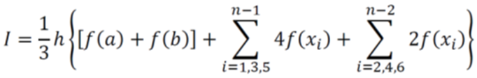
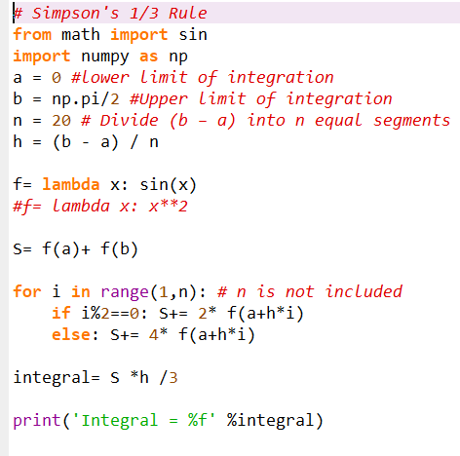
Simpson’s 1/3 Rule Code

Slide 67
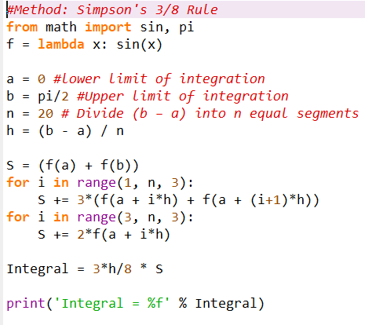

Simpson’s 3/8 Rule Code

